Slide 1

UNIVERSITY OF BUEA FACULTY OF ENGINEERING AND TECHNOLOGY DEPARTMENT OF COMPUTER ENGINEERING LEVEL 300
SOFTWARE DEVELOPMENT TOOLS CEF 333
GROUP 1 PRESENTATION WEEK FIVE:
Building a simple Web Application (HTML/CSS/JavaScript) and usage of Git pages and VS Code
S/N | GROUP MEMBER | MATRICULATION NUMBER
1. | LENYA SHAMPEL LENYA | FE23A001
2. | ACHUO PLACID ACHUO-ASSAM | FE23A004
3. | AFUH CHIKE CHEWAKONDI | FE23A005
4. | AGBORNJA BESONG AKPAK DIVINE | FE23A006
5. | AKOH JUNIOR NGOH | FE23A008
COURSE FACILITATOR: DR. NKEMENI Valery
COURSE FACILITATOR: DR. NKEMENI Valery

Slide 2

Building simple webpage(HTML,CSS,JAVASCRIPT) and Deploy using Github page
COURSE FACILITATOR: DR. NKEMENI Valery

Slide 3
Web Development's Core
Webpage
VS Code
A webpage is a browser-displayed document built with HTML, CSS, and JavaScript. HTML structures content, CSS styles it, and JavaScript adds interactivity.
VS Code is a powerful IDE with extensions for live server preview, error checking, debugging, and Git integration, boosting developer efficiency.
Git
Workflow
Git, a version control system, tracks code changes, facilitates collaboration, and enables easy project versioning and deployment (e.g., GitHub Pages).
Web development workflow involves planning, coding (HTML, CSS, JavaScript in VS Code), Git-based version control, and final deployment and testing.
Notes:
Web development is the foundation of the modern internet, enabling the creation of dynamic, interactive websites and web applications. At the core of web development are a few key technologies and tools that every web developer should be familiar with. Today, we'll explore these core elements of web development and how they work together to build powerful online experiences. We'll also discuss the importance of using an integrated development environment (IDE) like Visual Studio Code and leveraging version control with Git to streamline the development process.

Slide 4



Modern Web Development: A Collaborative Effort
1
HTML
2
CSS
3
JavaScript

Slide 5
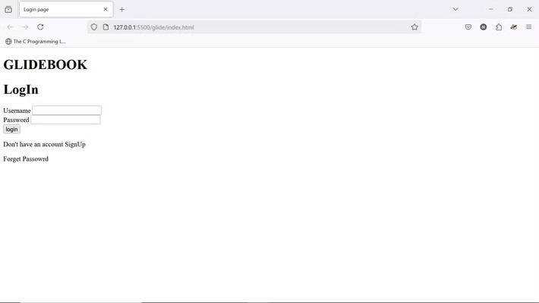
HTML: The Foundation
Structure
Elements and Tags
Attributes
HTML uses tags to define elements, forming a hierarchical structure of content.
Tags are the building blocks, often in pairs, enclosing content like paragraphs and headings.
Attributes provide extra information about an element, like image source and alternative text.
Login page with HTML
Notes:
HTML is the foundation of the web, providing the structure and content for web pages HTML uses tags to define the different elements on a page, creating a hierarchical structure These tags often come in pairs, with an opening and closing tag, to enclose the content like paragraphs and headings Attributes provide extra information about an element, such as the source of an image or alternative text Understanding the basic building blocks of HTML - the structure, elements/tags, and attributes - is crucial for creating web content

Slide 6

CSS: Styling the Web
1
Selectors
2
Properties and Values
Selectors target specific HTML elements for styling, based on tags, classes, and IDs.
Properties like color, font, and spacing are assigned values to control visual presentation.
3
Box Model
Each HTML element is treated as a box, enabling control over margins, padding, borders, and content.

Slide 7
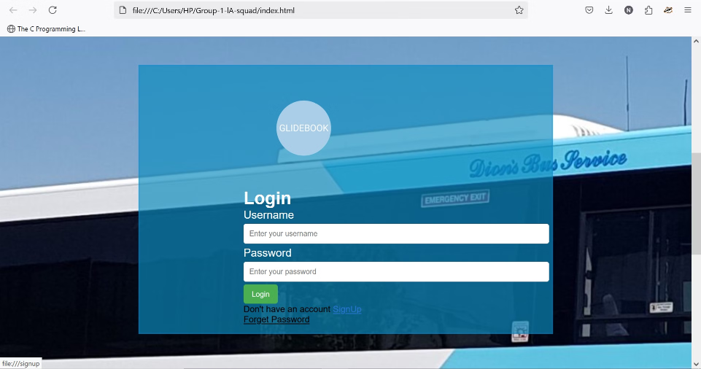
CSS: Styling and Functionality
Backgrounds and Borders
Text Styling
Background images, padding, margins, and borders were successfully implemented.
Text color and font styles were applied.
Input Icon Shaping
Interactive Hover Effects
Input icon size and shape were adjusted.
Hover effects with color changes were implemented.

Slide 8



JavaScript: Bringing Web Pages to Life
Event Handling
Web Applications
Dynamic Content
Manages user interactions like clicks, hovers, and form submissions for responsive web pages.
JavaScript powers frameworks such as React, Angular, and Vue.js for complex web application development.
JavaScript updates web page content without reloading, creating interactive experiences.

Slide 9



JavaScript's Role in Login Pages
Client-Side
Server-Side
Validates user inputs, provides error messages, and implements features like password visibility.
Processes credentials, encrypts passwords, and handles secure data transmission with Node.js.

Slide 10
Creating the GitHub Pages Site
GitHub pages is designed to host personal web projects from your GitHub repository

Slide 11
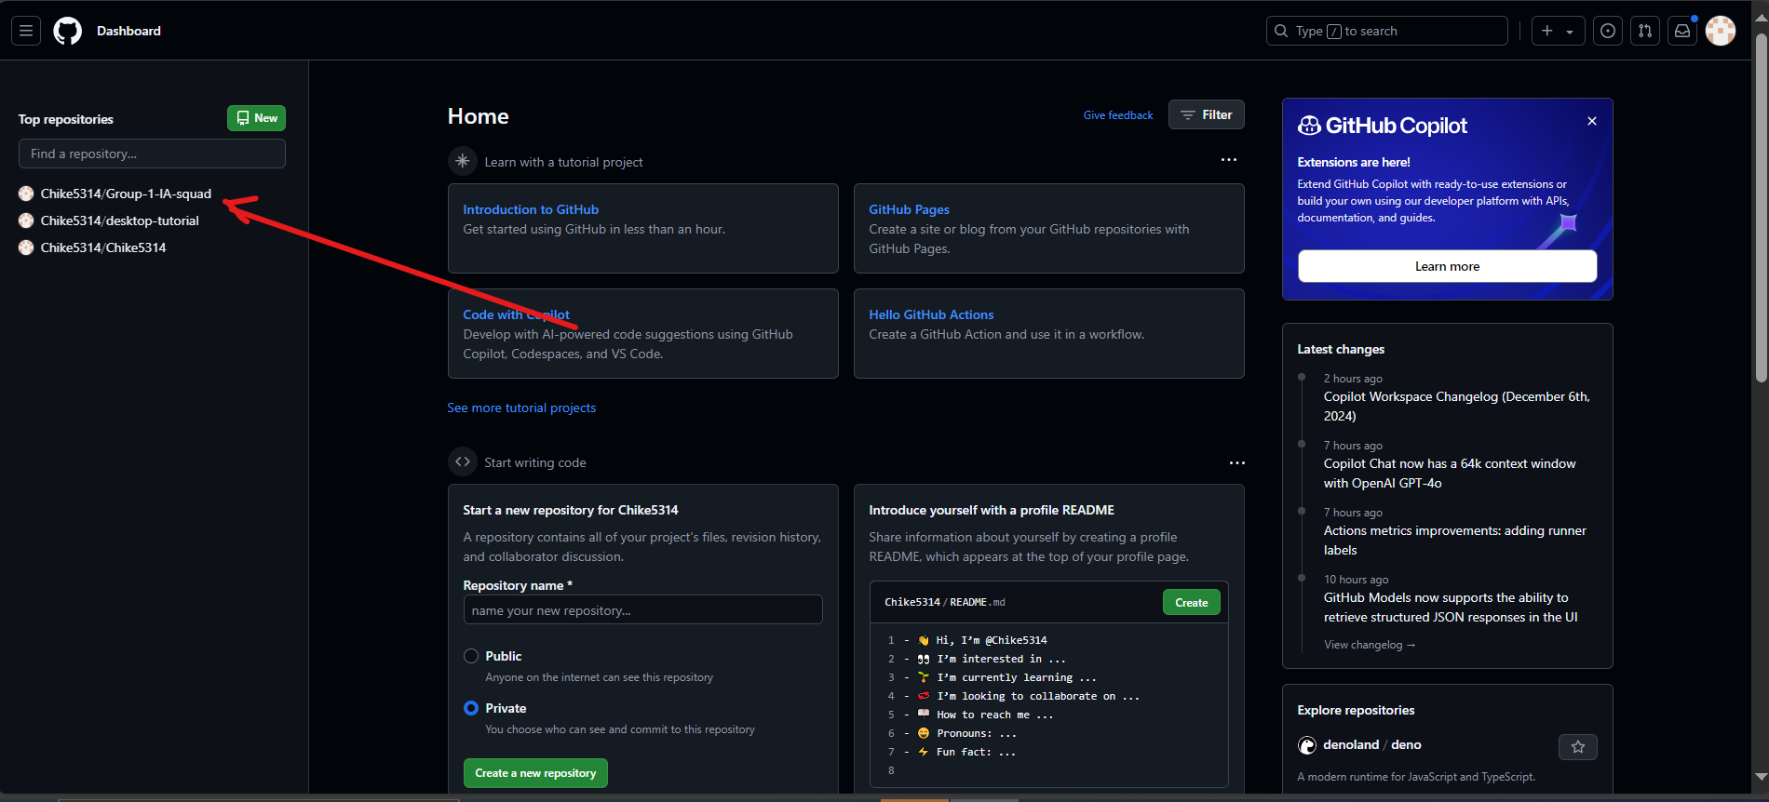
Step 1: Create a Repository
Since we've already created repositories in a previous presentation, we'll use that one.
Repository: https://github.com/Chike5314/Group-1-lA-squad

Slide 12
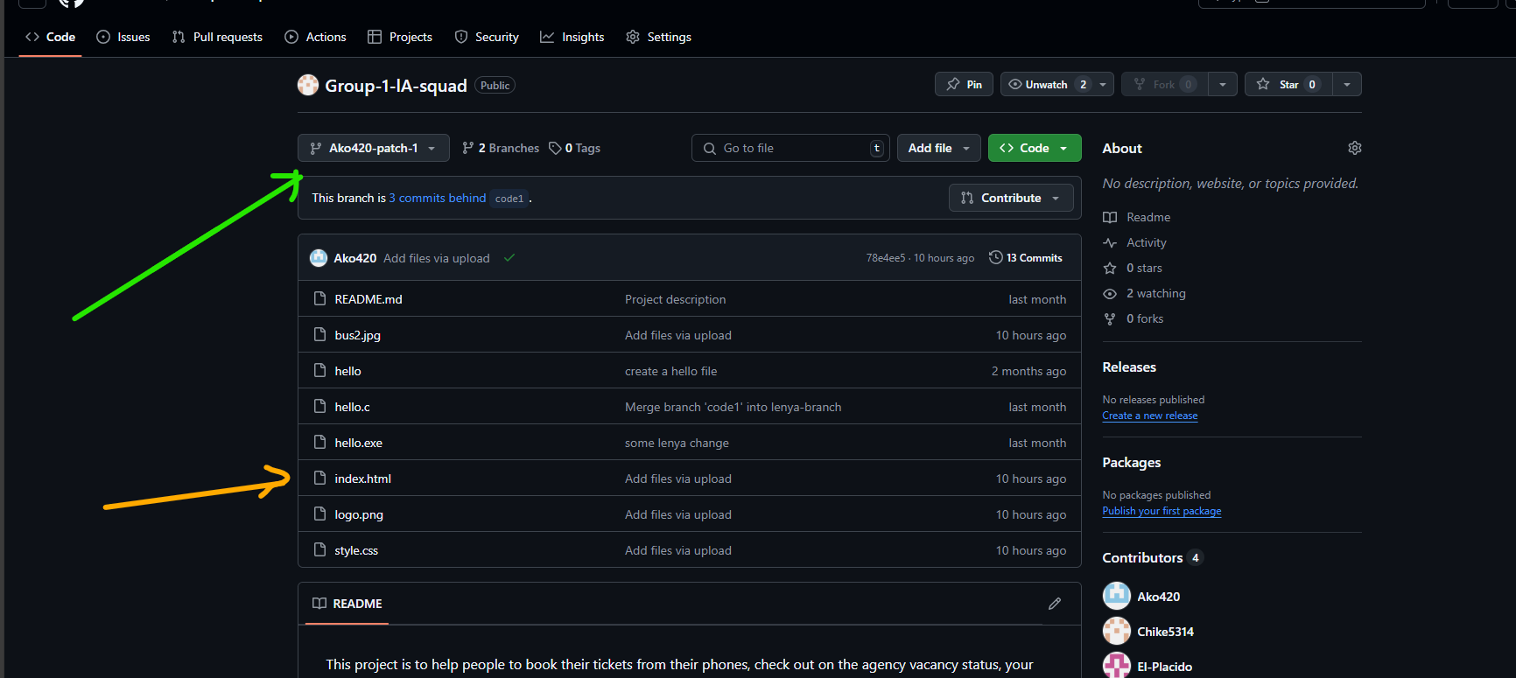
Step 2: Add Content
Content for your site must be added to the repository
GitHub Pages looks for an index.html file as the entry point of your site.

Slide 13
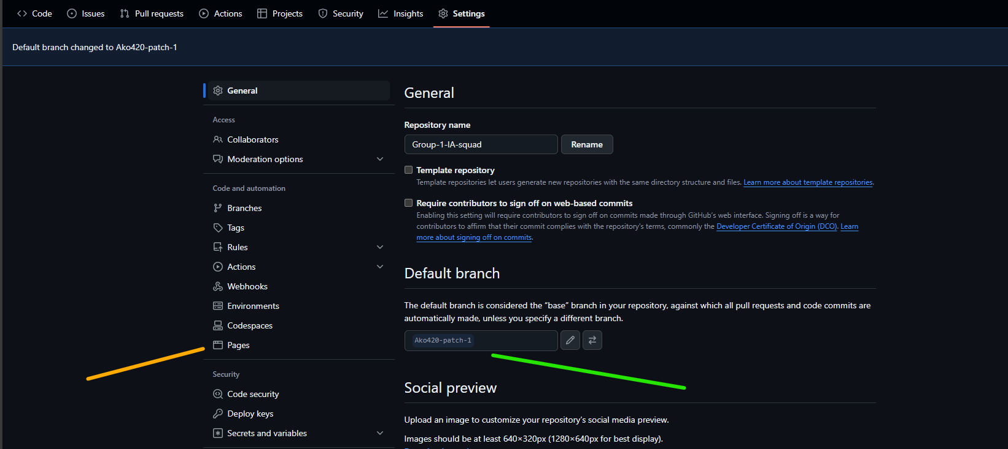
Step 3: Configure publishing source
Navigate to the repository settings, select "code and automation," then "pages".
Select the branch or folder where your site content is located.

Slide 14
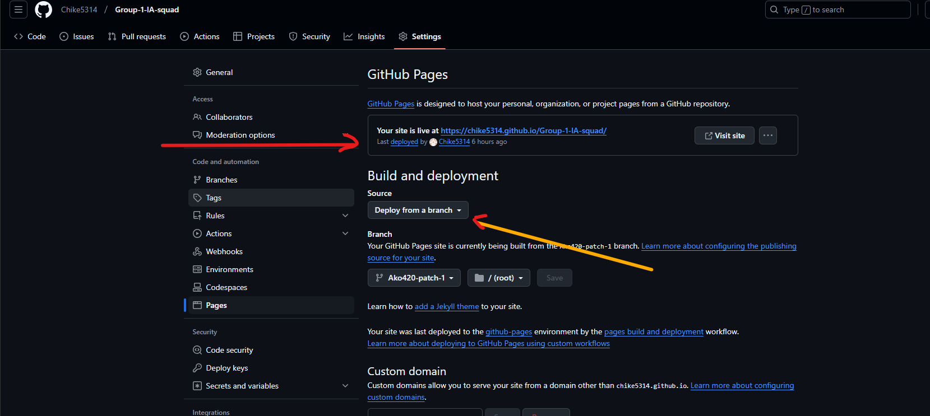
Step 4: Publish your site
Next, once you have configured the publishing source your site will be published.
It might take up to 10 minutes for changes to be reflected.
You can visit your site by clicking on the “visit site” link under the “GitHub pages” section in the repository settings

Slide 15
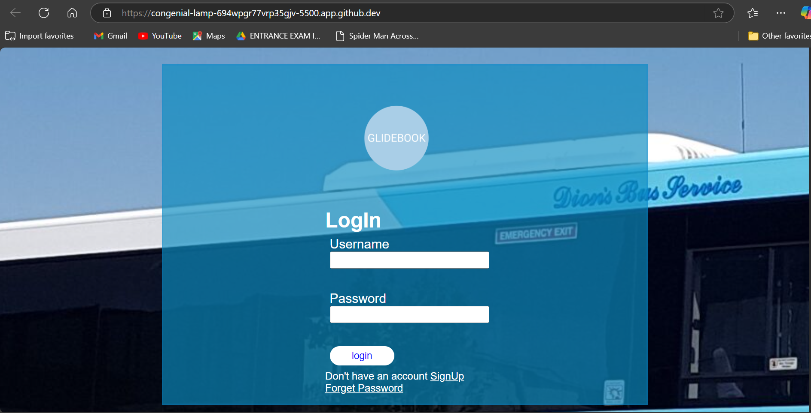
Published site: Website Demo

Slide 16
Getting VSCode Set

Slide 17
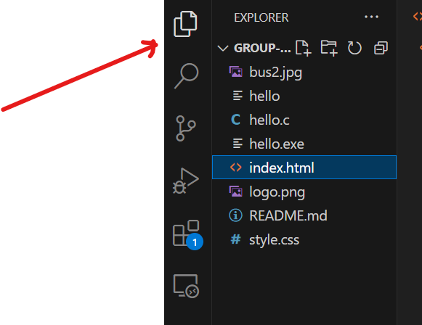
Creating a new HTML Template in VSCode
Open vs code and create a new file by clicking on the explorer icon from the activity bar then clicking on new file

Slide 18
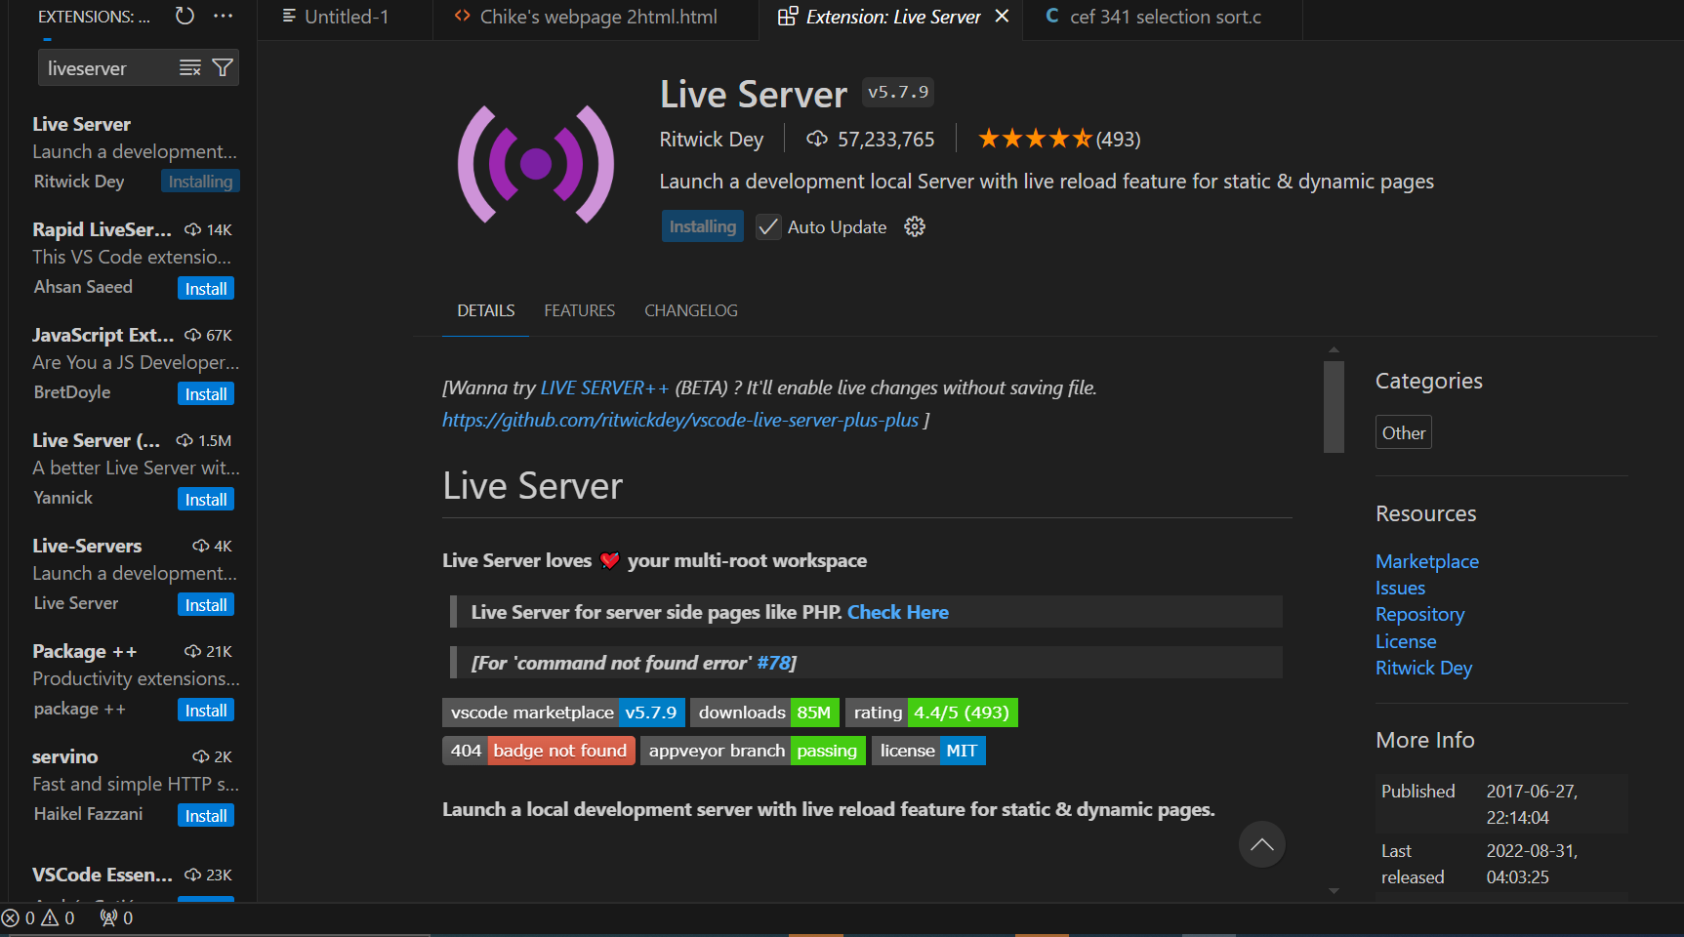
Running live Server
Install the extension for live server from the extensions option from the liveServer

Slide 19
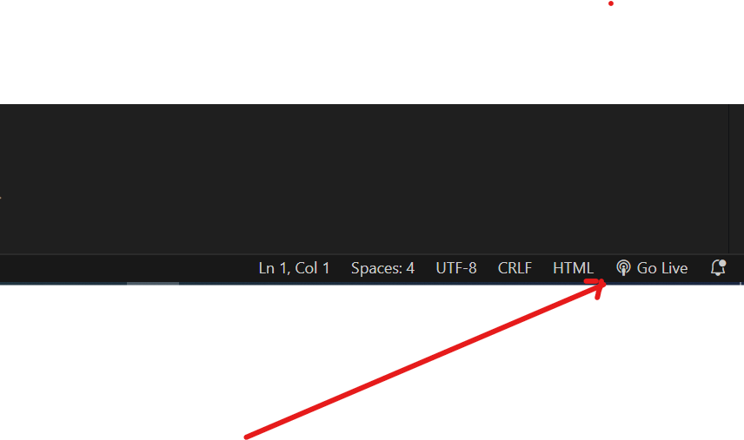
Using live server to “Go Live”
Look for the “go live” option in the blue taskbar at the bottom . Click on the “go live” option and it will automatically map to a port and open it in the browser

